Slide 1
MolSim WS 23/24
Sheet 5
Membranes, Parallelization, Contest No.2,
Nano-scale flow and Crystallization of Argon
Group C [Manuel, Tobias, Daniel]
02.02.2024

Slide 2
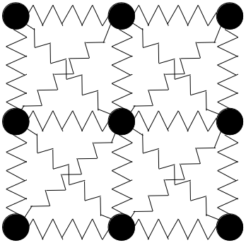
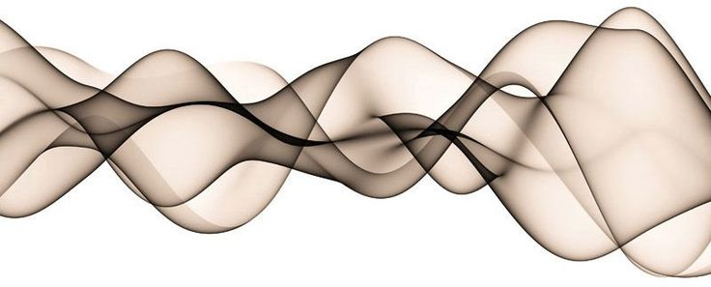
Simulation of a membrane
Harmonic Force
⇒ save neighbors for each particle
⇒ save spring constant k
The temporary force
⇒ acts on selected set of particles
⇒ acts for a specified amount of time
No Outflow boundaries

Slide 3
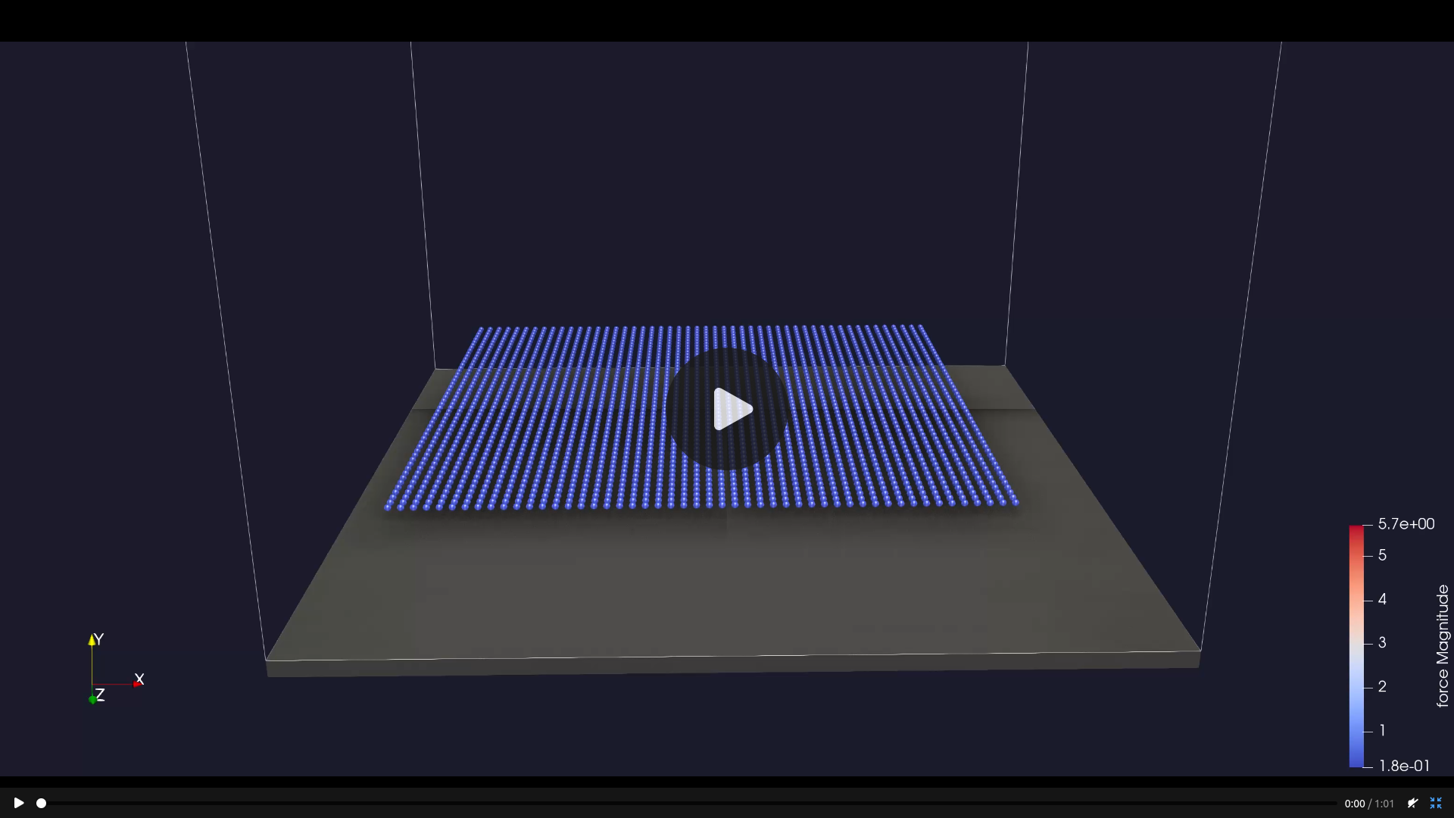
Simulation of a membrane

Slide 4
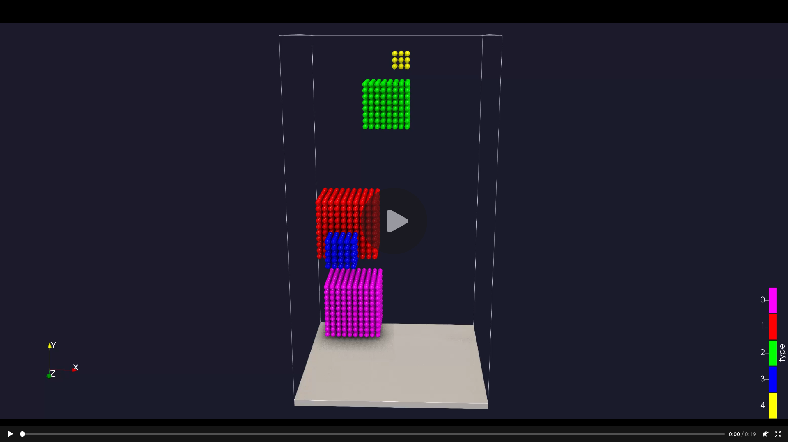
Simulation of a membrane

Slide 5
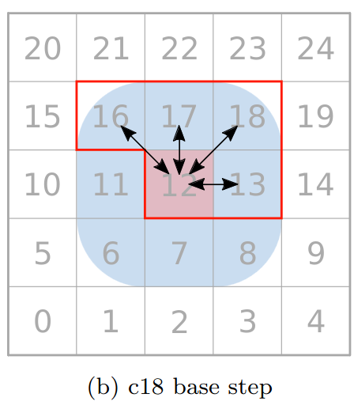
Parallelization
Domain Partitioning
Domain partitioning:
Parallelization works on a linearized queue of list of Cells
⇒ this queue differentiates the 2 methods
All members of 1 list can be worked on in parallel without race conditions
⇒ deterministic result

Slide 6
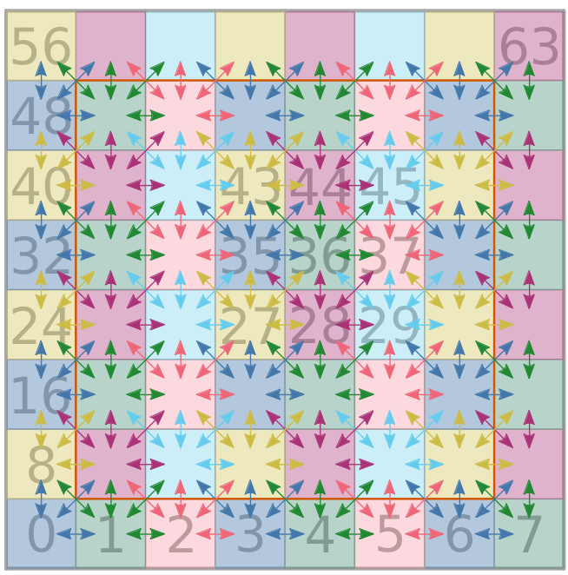
Parallelization
Domain Partitioning
Domain partitioning:
Parallelization works on a linearized queue of list of Cells
⇒ this queue differentiates the 2 methods
All members of 1 list can be worked on in parallel without race conditions
⇒ deterministic result
⇒ faster than second method

Slide 7
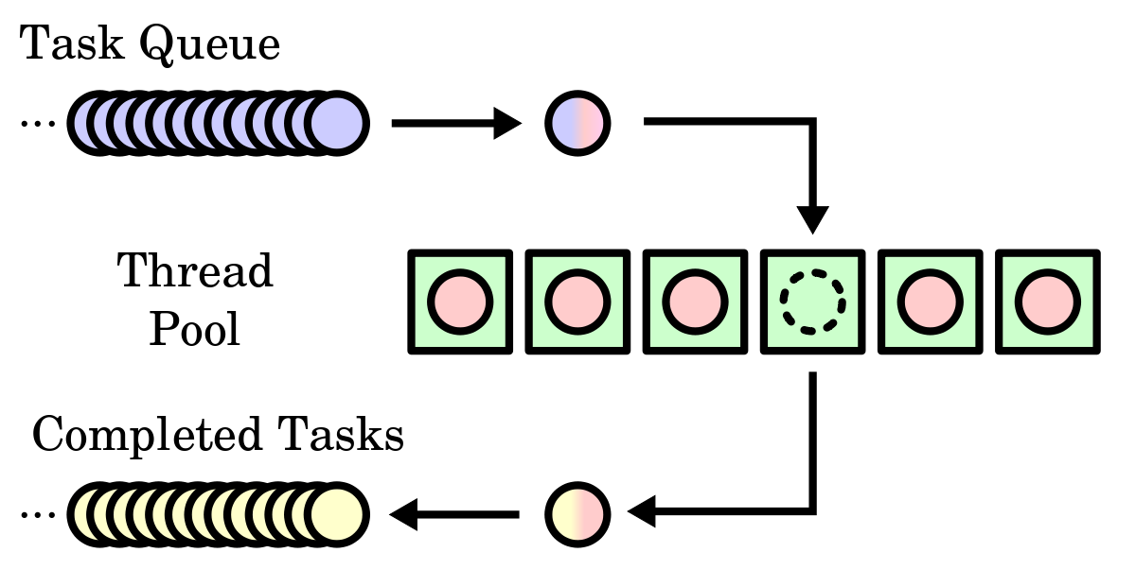
Parallelization
Particle Locking
Particle Locking:
Mutexes on the level of particles
The list of cells in our queue is sorted randomly
⇒ very little idle time in big examples because of randomization
⇒ not deterministic
⇒ order of calculation matters a lot in chaotic systems

Slide 8
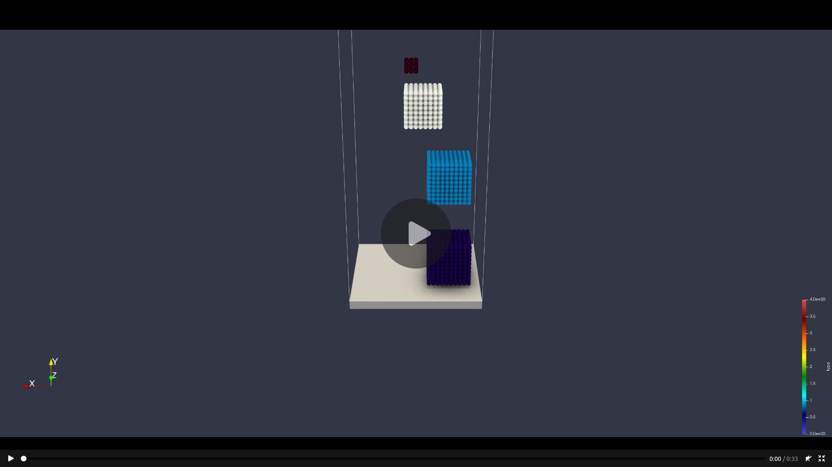
Parallelization
Particle Locking

Slide 9
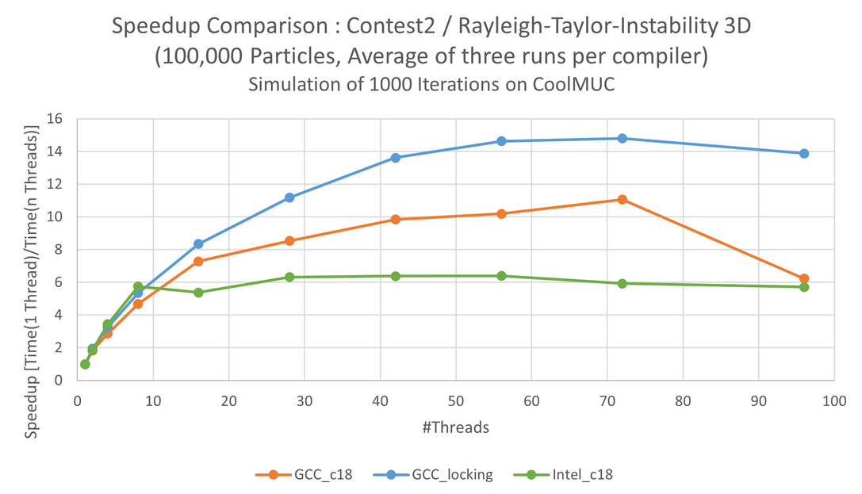
Performance: Speedup

Slide 10
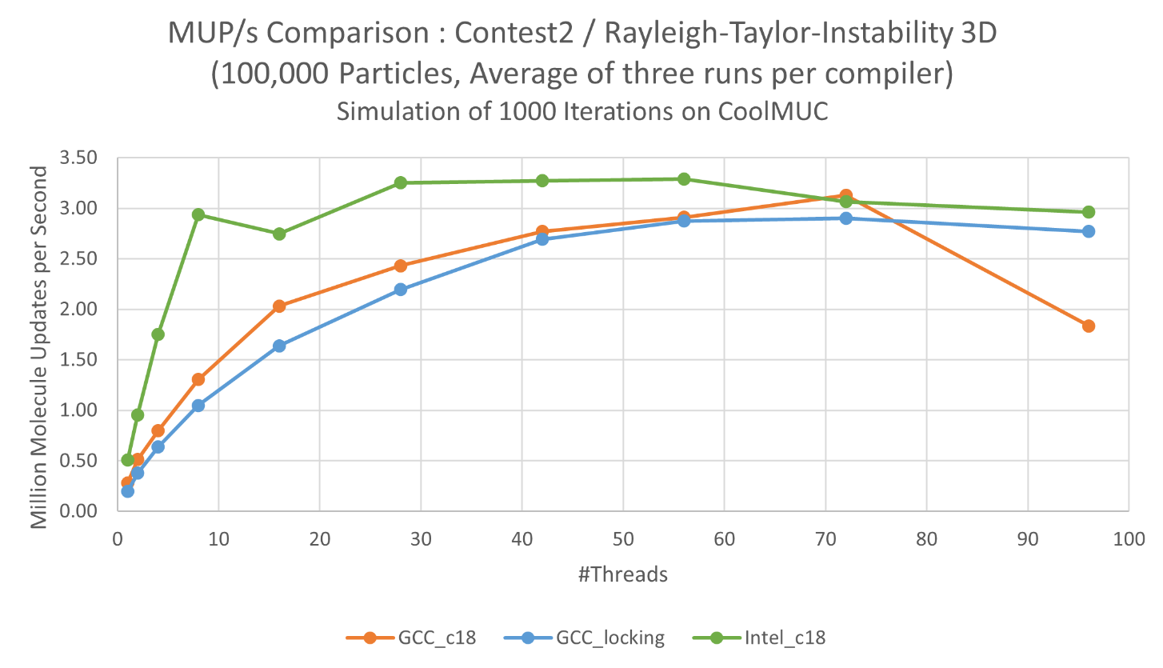
Performance: MUP/s

Slide 11
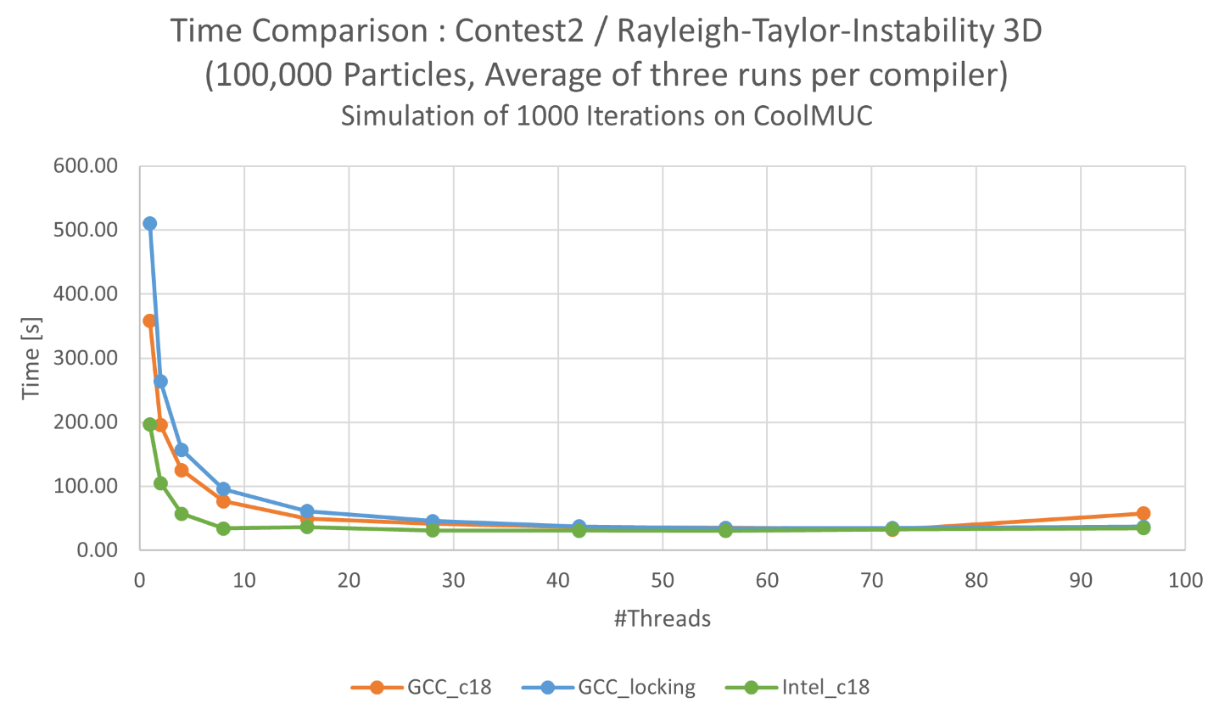
Performance: Time

Slide 12
Contest 2: Rayleigh-Taylor-Instability
Remarks:
42 is the optimal amount of threads (obviously)
Intel compiler has the best performance
Data:
27.323 seconds
3 659 920 MUP/s
⇒ 7x Speedup

Slide 13
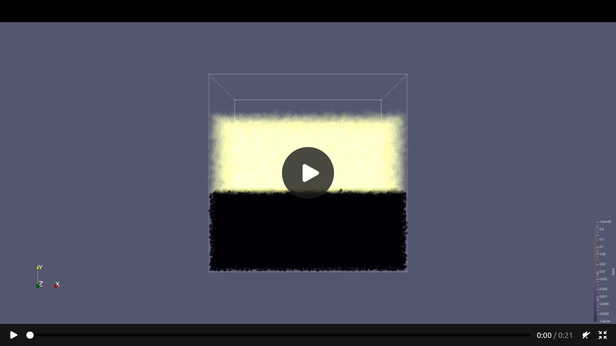
Contest 2: Rayleigh-Taylor-Instability

Slide 14

Nano-scale flow simulation
1
New features:
Fixed flag for particles
New thermostat interceptor
Simulations:
Unhindered flow
Cuboid obstacle
Spherical obstacle
High velocity

Slide 15
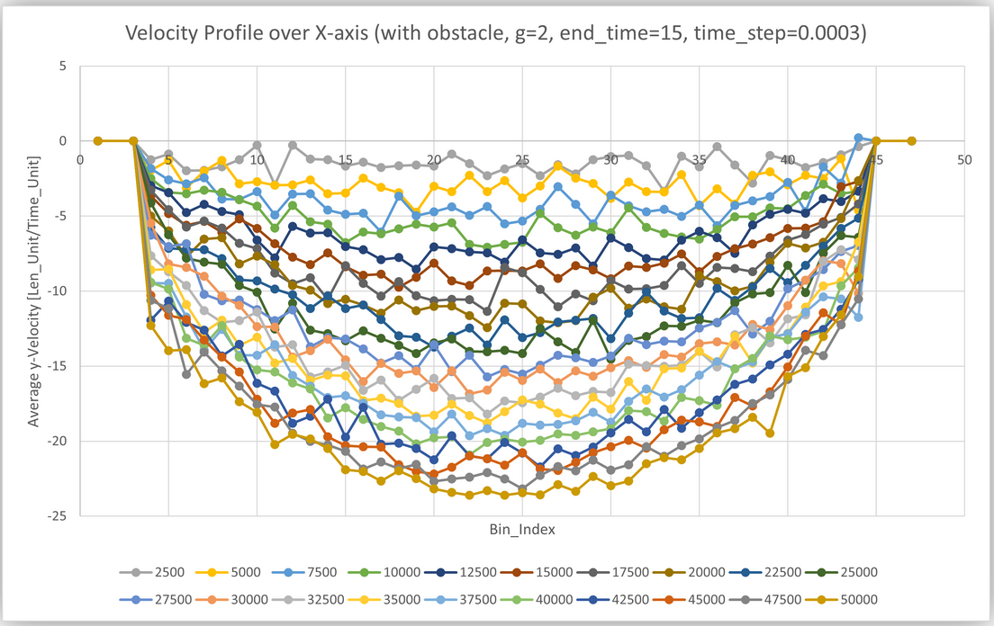
Nano-scale flow simulation
1
New features:
Fixed flag for particles
New thermostat interceptor
Simulations:
Unhindered flow
Cuboid obstacle
Spherical obstacle
High velocity

Slide 16
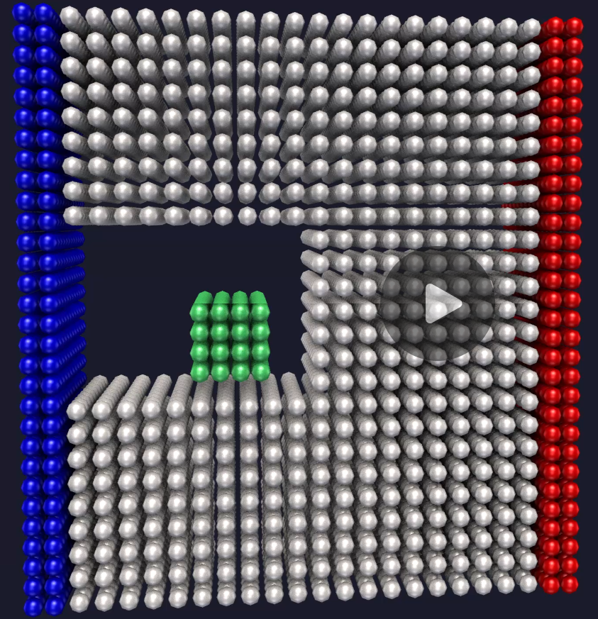
Nano-scale flow simulation
2
New features:
Fixed flag for particles
New thermostat interceptor
Simulations:
Unhindered flow
Cuboid obstacle
Spherical obstacle
High velocity

Slide 17
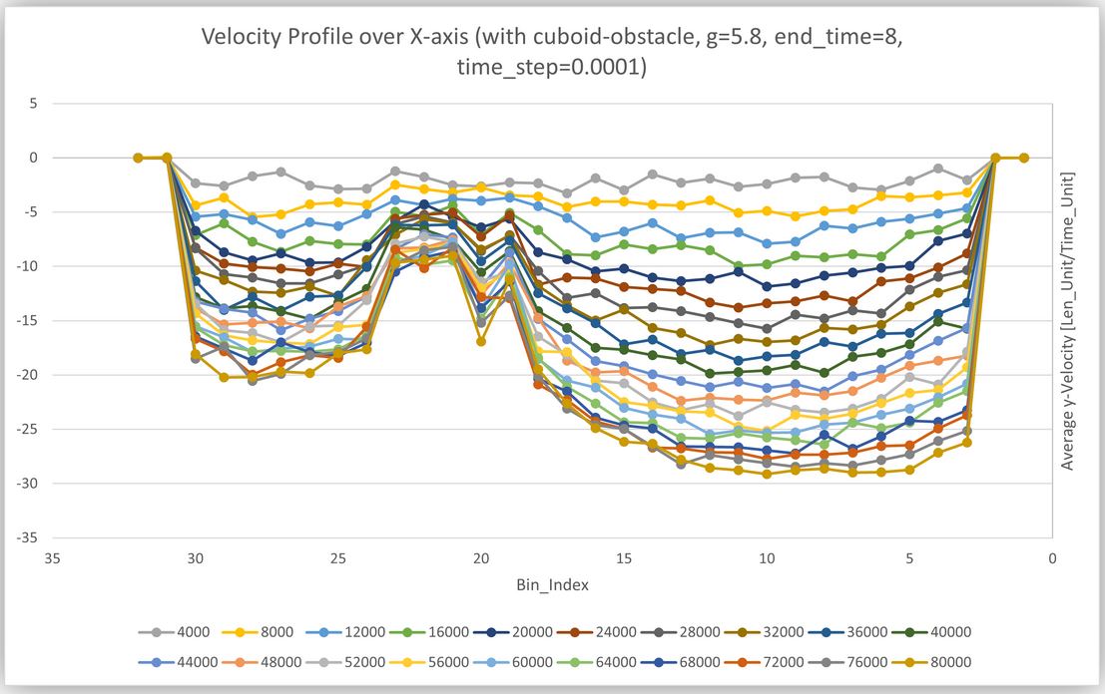
Nano-scale flow simulation
2
New features:
Fixed flag for particles
New thermostat interceptor
Simulations:
Unhindered flow
Cuboid obstacle
Spherical obstacle
High velocity

Slide 18
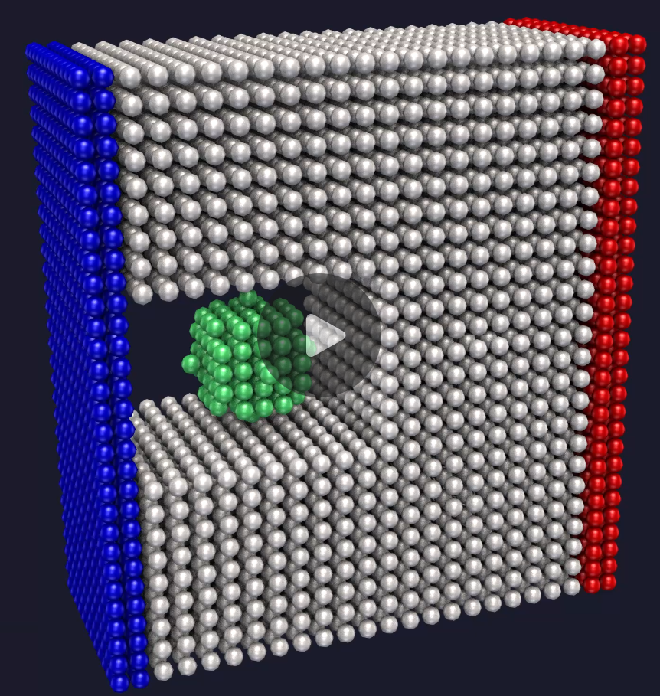
Nano-scale flow simulation
3
New features:
Fixed flag for particles
New thermostat interceptor
Simulations:
Unhindered flow
Cuboid obstacle
Spherical obstacle
High velocity

Slide 19
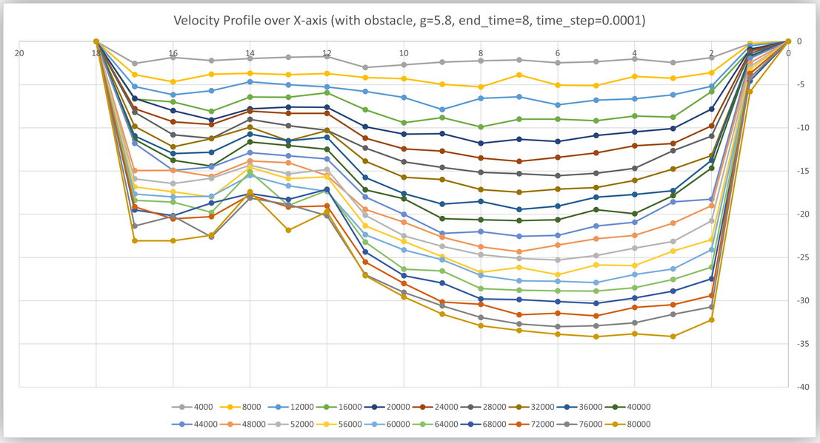
Nano-scale flow simulation
3
New features:
Fixed flag for particles
New thermostat interceptor
Simulations:
Unhindered flow
Cuboid obstacle
Spherical obstacle
High velocity

Slide 20
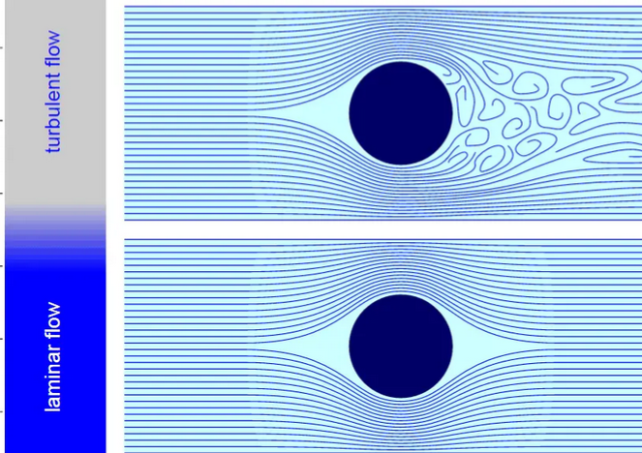
Nano-scale flow simulation
4
New features:
Fixed flag for particles
New thermostat interceptor
Simulations:
Unhindered flow
Cuboid obstacle
Spherical obstacle
High velocity

Slide 21
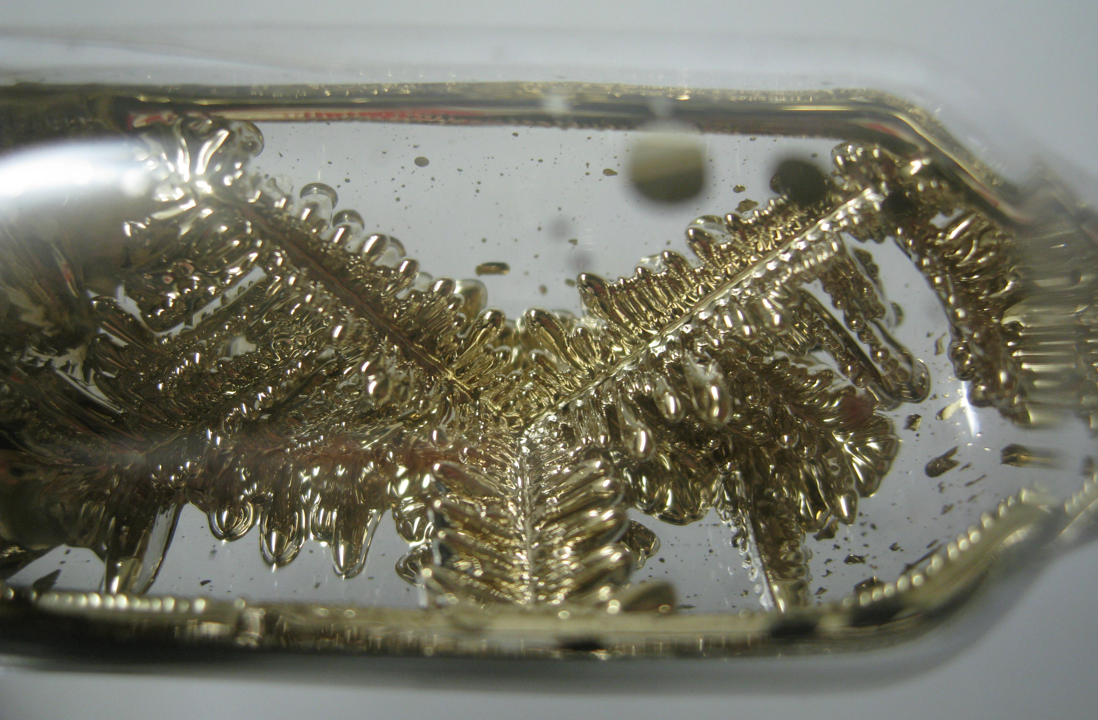
Crystalization of Argon
Implementation:
Smoothed Lennard Jones Potential
Measurements as Interceptors
Qualitative Analysis:
Energy is taken out of the system until the attractive LJ outweighs Temperature
Smaller and more holes in supercooled crystal

Slide 22
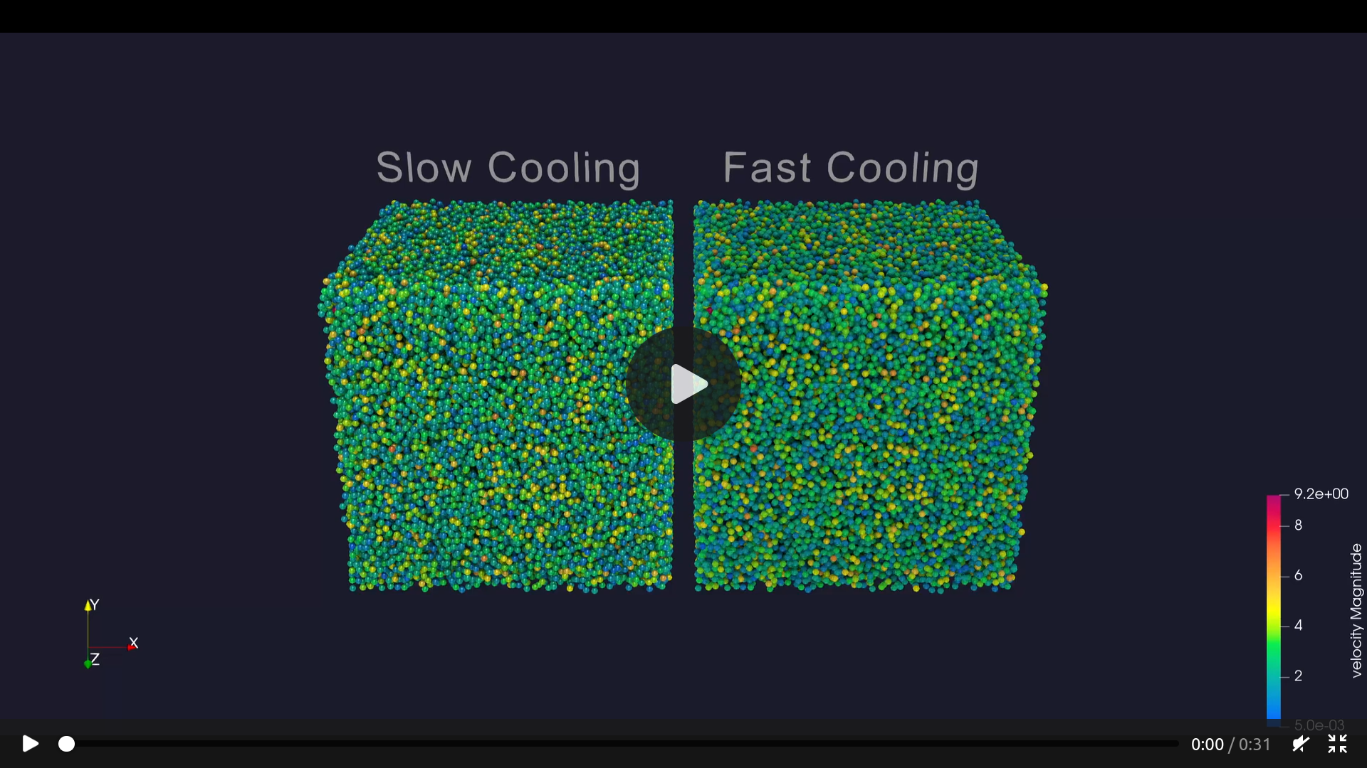
Crystalization of Argon

Slide 23
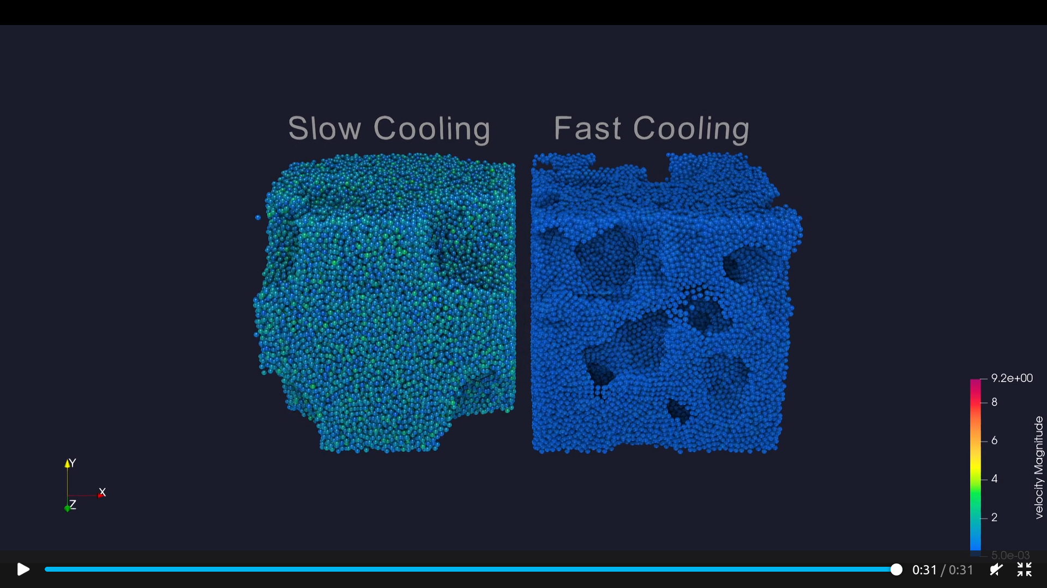
Crystalization of Argon

Slide 24
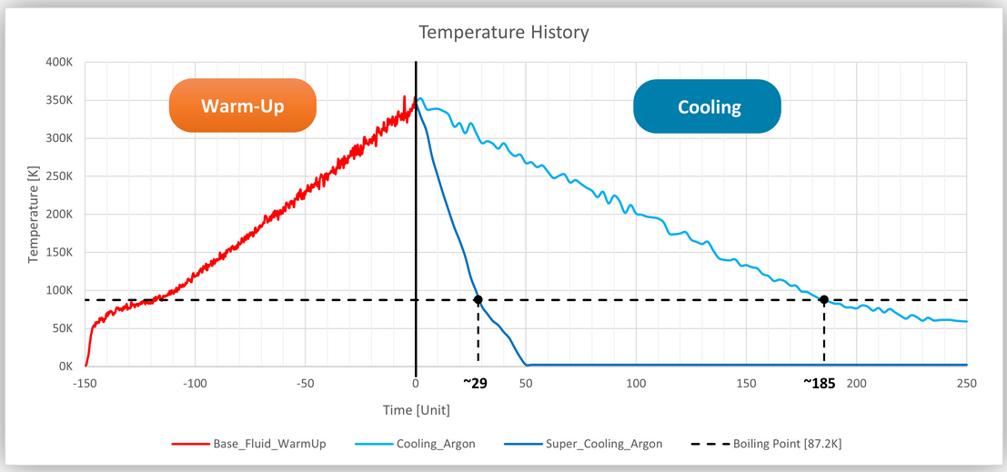
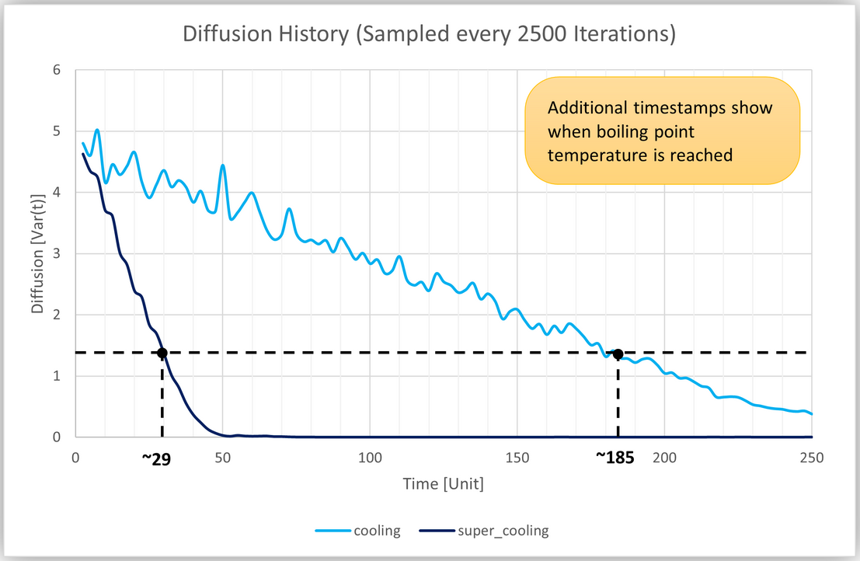
Crystalization of Argon
Quantitative Analysis:
Diffusion & Temperature History
Radial Distribution Function
Explanation:
Fast nucleation rate
Less time to distribute in space

Slide 25
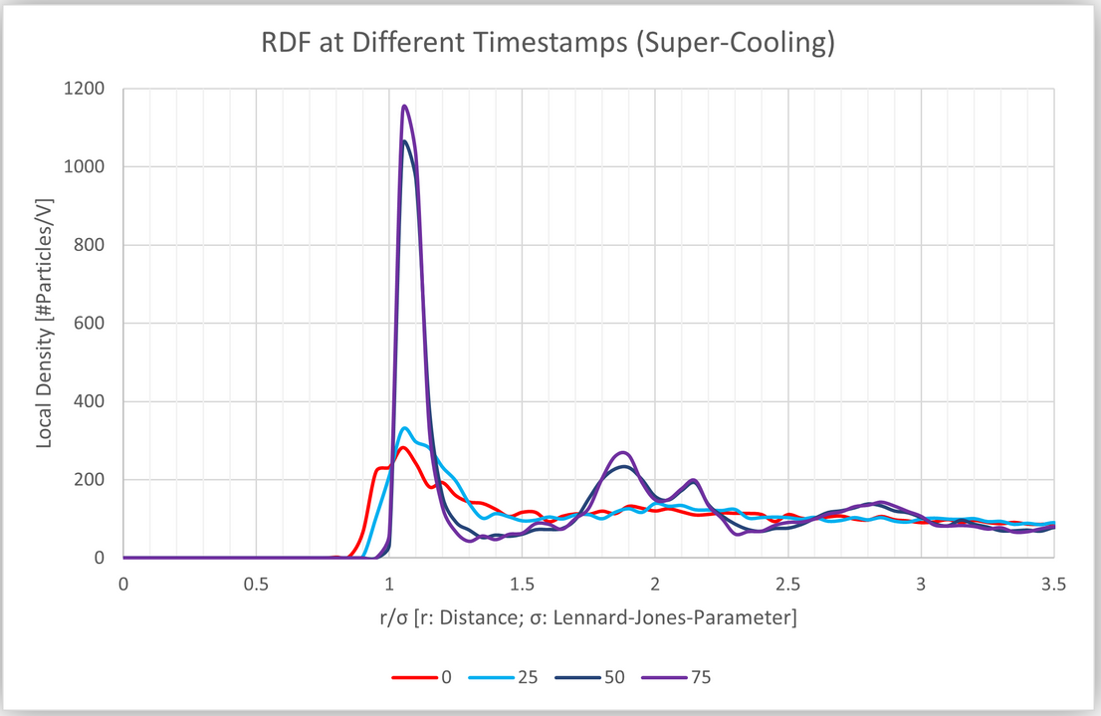
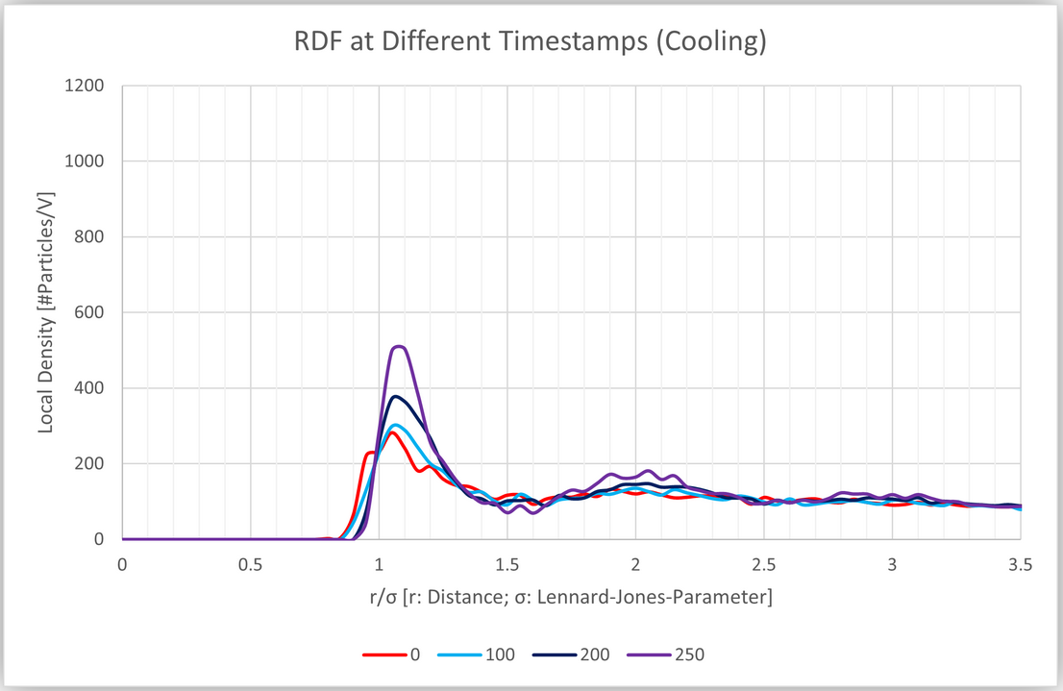
Crystalization of Argon
Quantitative Analysis:
Diffusion & Temperature History
Radial Distribution Function
Explanation:
Fast nucleation rate
Less time to distribute in space

Slide 26
Summary of cool things
We made a satisfying simulation of rubber cubes
We read a paper by Prof. Bungatz
We accelerated the simulation by threading
We observed unstable chaotic system
We analysed a particle flow on nano-scale
We ran hours of argon simulation

Slide 27
References
Waves: https://www.pinterest.de/pin/harmonic-waves-in-architecture-google-search-musicperformance-music-performance-architecture--690247080384012557/
Domain partitioning: https://www.researchgate.net/profile/Fabio-Gratl/publication/357143093_N_Ways_to_Simulate_Short-Range_Particle_Systems_Automated_Algorithm_Selection_with_the_Node-Level_Library_AutoPas/links/649acc9cc41fb852dd355f24/N-Ways-to-Simulate-Short-Range-Particle-Systems-Automated-Algorithm-Selection-with-the-Node-Level-Library-AutoPas.pdf
Threads: https://en.wikipedia.org/wiki/Thread_pool
Reynolds number https://www.nuclear-power.com/nuclear-engineering/fluid-dynamics/reynolds-number/reynolds-number-for-turbulent-flow/
Argon crystal https://en.wikipedia.org/wiki/Argon#/media/File:CsCrystals.JPG

